Slide 1
Georgia EMGrantsPro Training for Homeland Security Grant Program and Nonprofit Security Grant Program
Preparedness Grants & Programs
Hsgrants@gema.ga.gov
(404) 635-7095

Slide 2
Progress Payment Requests
Time Extensions
Budget Adjustments
Progress Reports

Slide 3
Progress Payment Requests

Slide 4
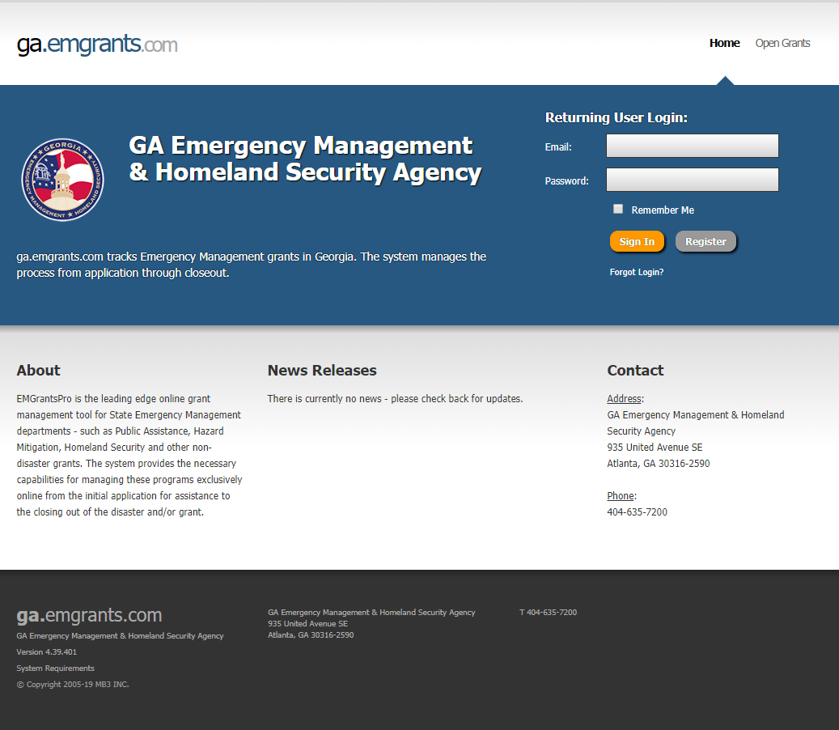
Please access Georgia EMGrantsPro portal by following the link provided: https://ga.emgrants.com
Enter your Email and Password
Select Sign In

Slide 5
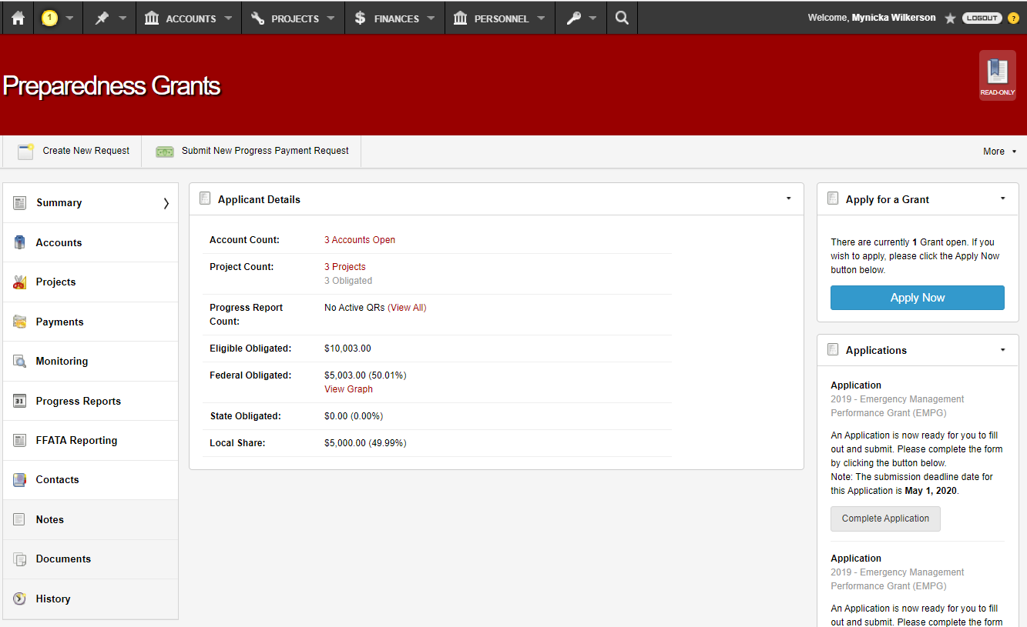
Select Projects

Slide 6
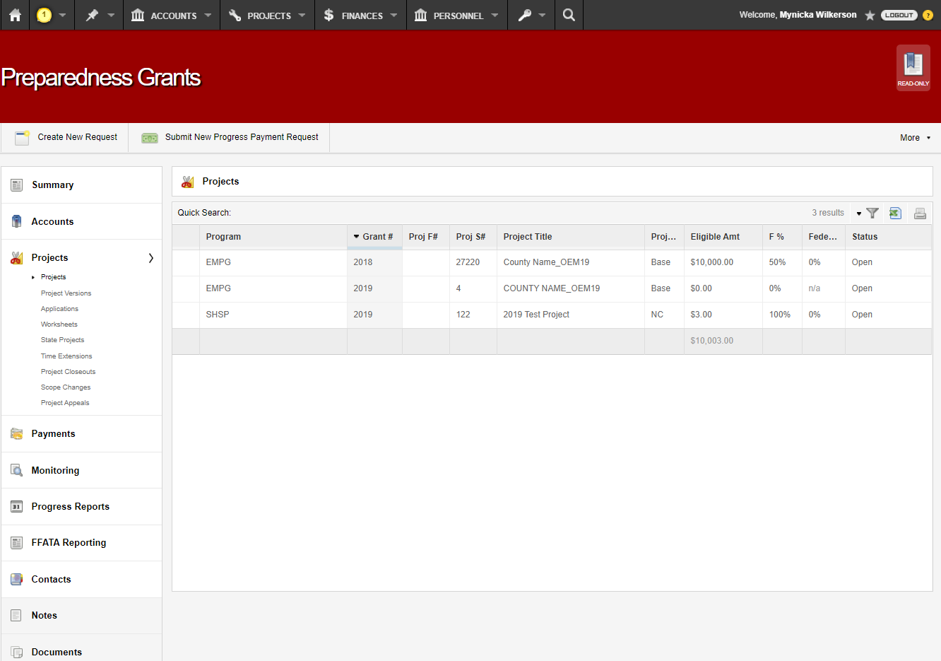
Select the Project to process your Payment Request

Slide 7
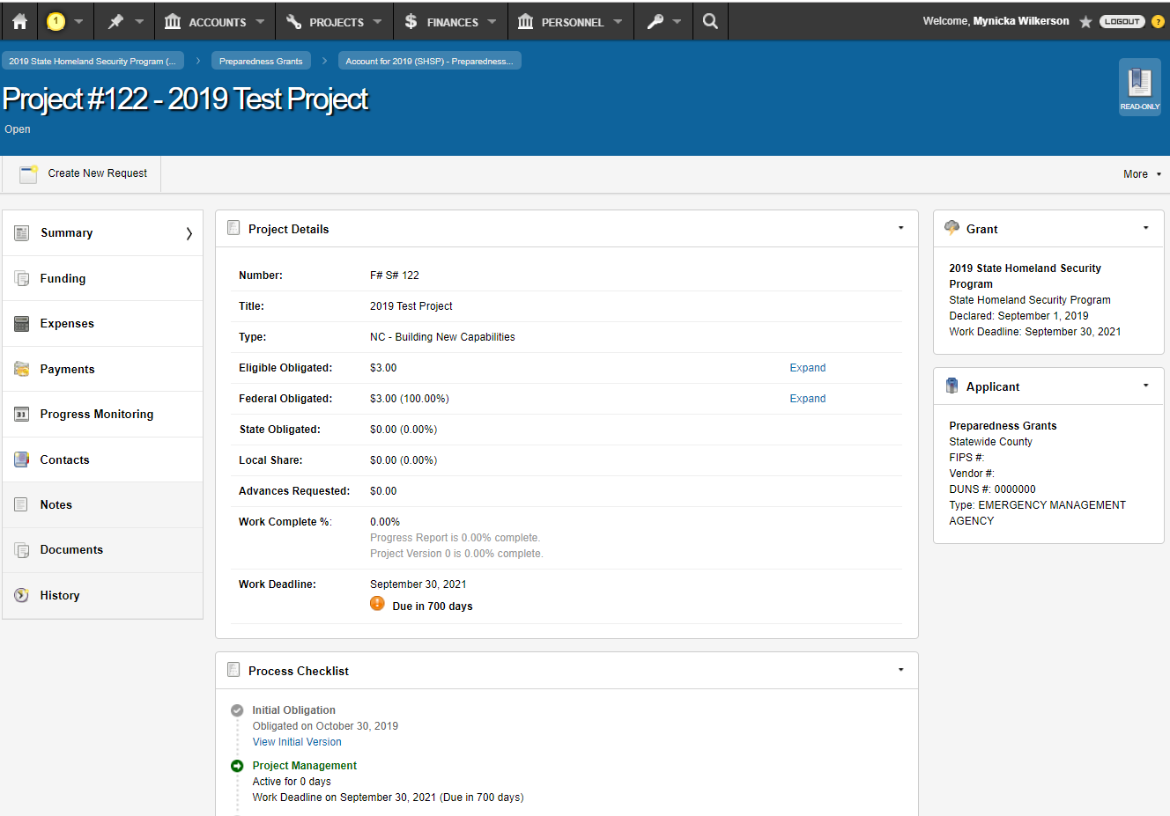
Select Create New Request

Slide 8
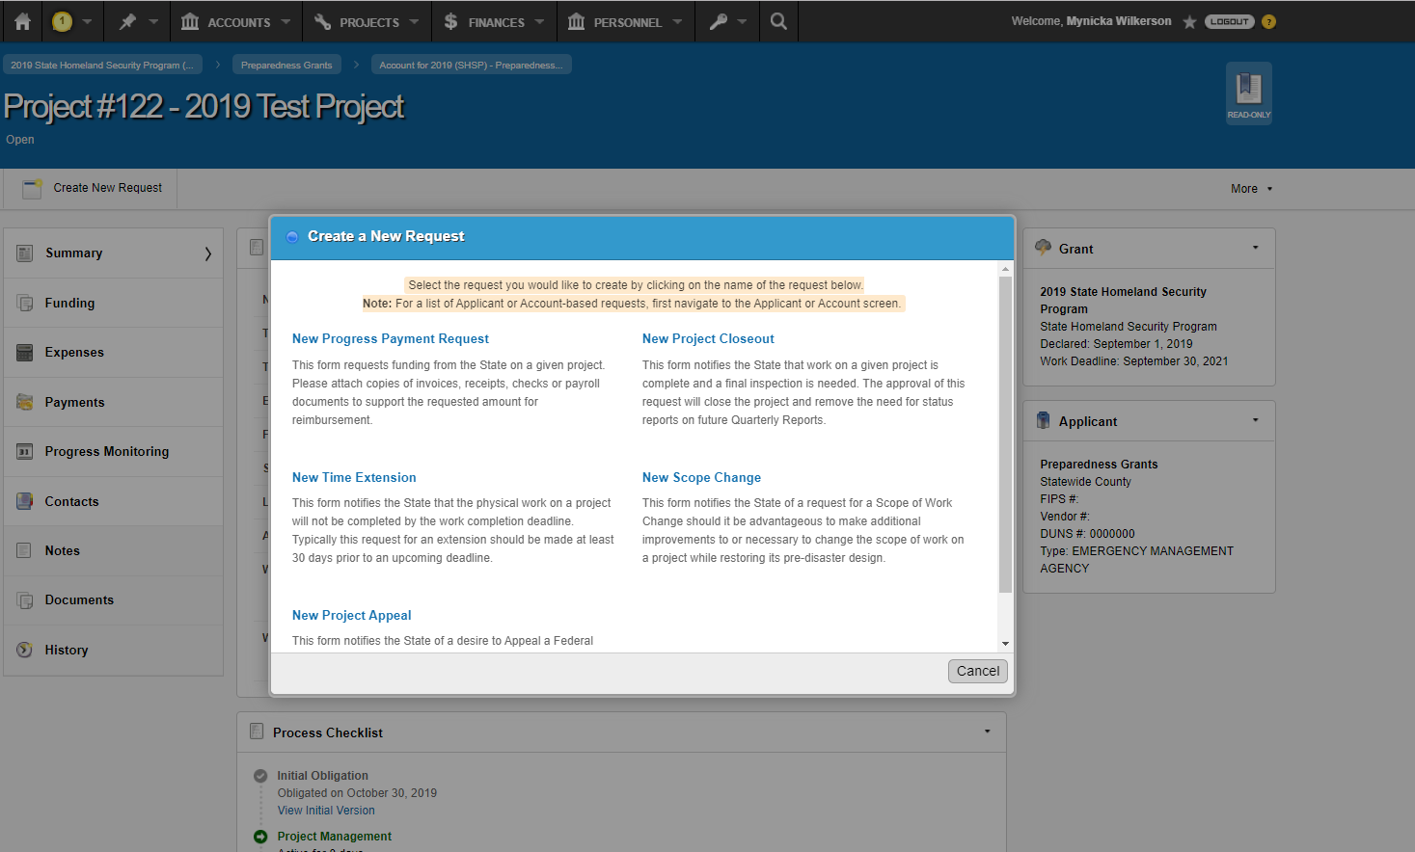
Select New Progress Payment Request

Slide 9
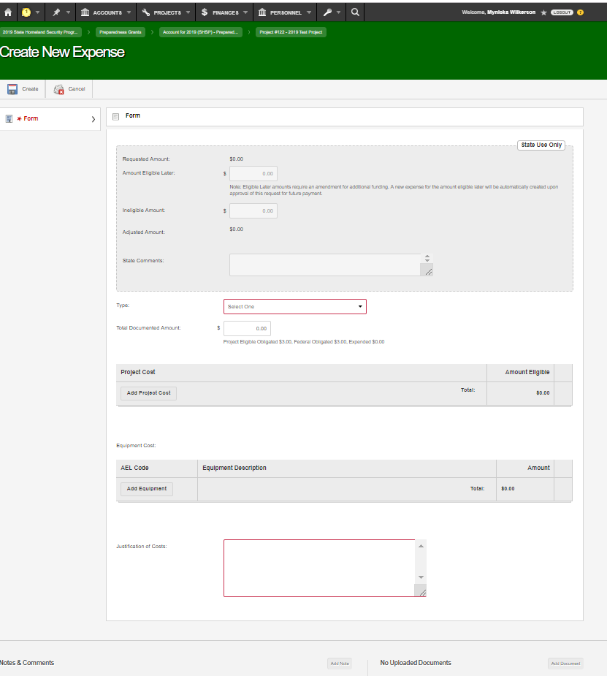

Slide 10
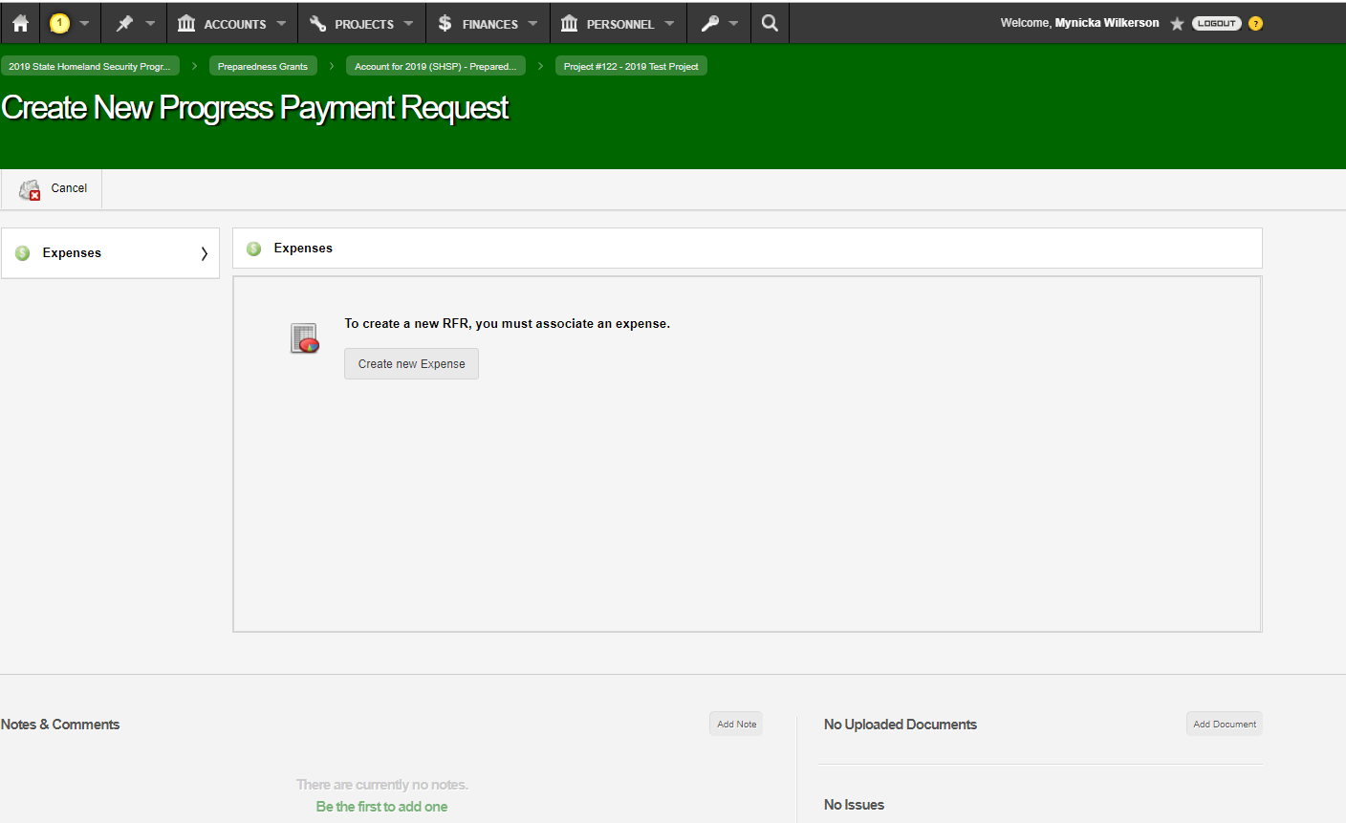
Select Create New Expense

Slide 11
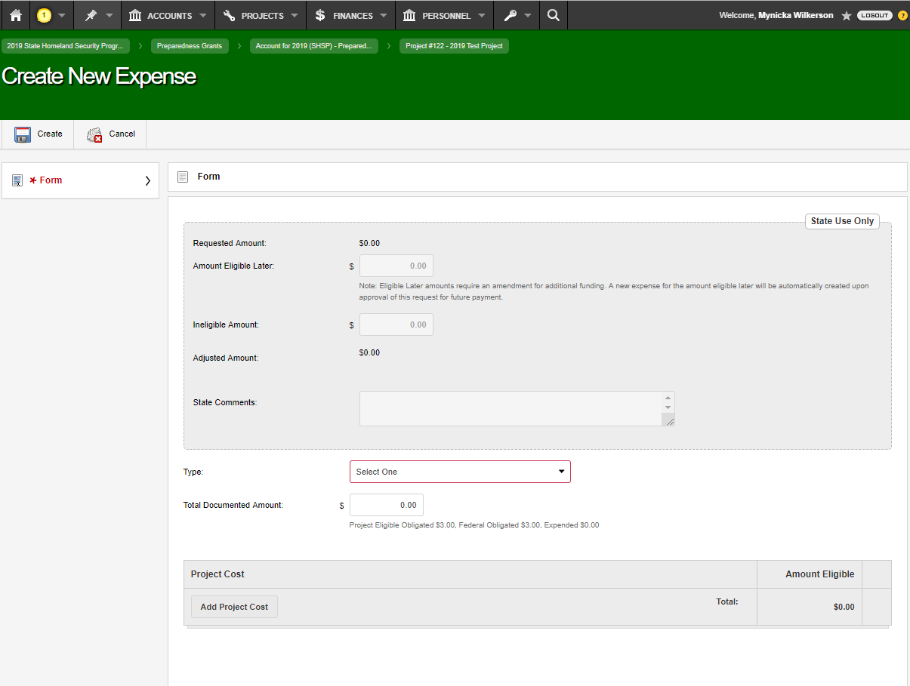
Select the Type from the Drop Down.

Slide 12
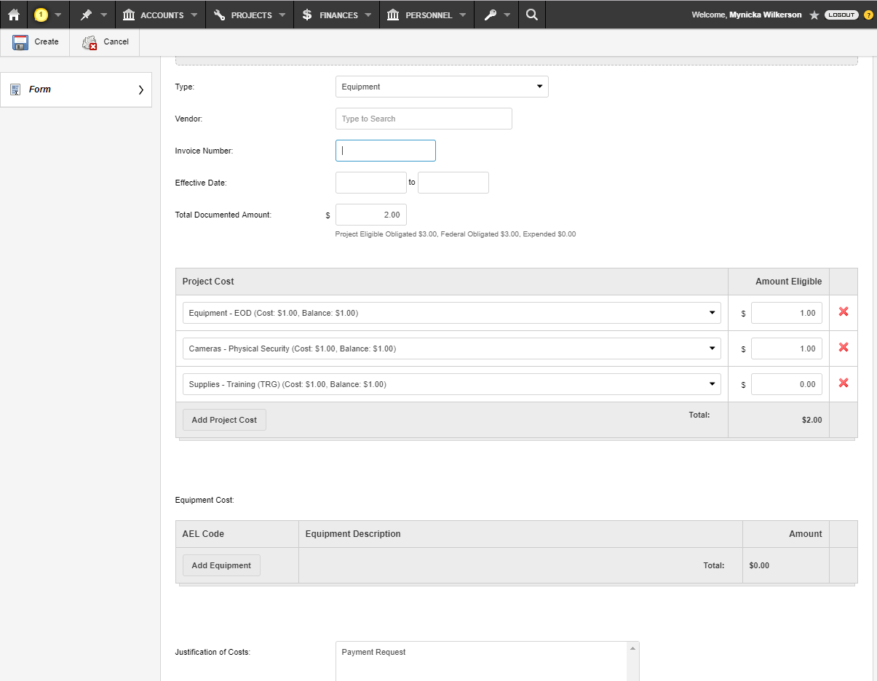
Enter the Total Payment Request amount in the Total Documented Amount field
Select Add Project Cost to select the Cost Line item, then enter the amount requested.
Enter a comment in the Justification of Costs box.
Select Create

Slide 13
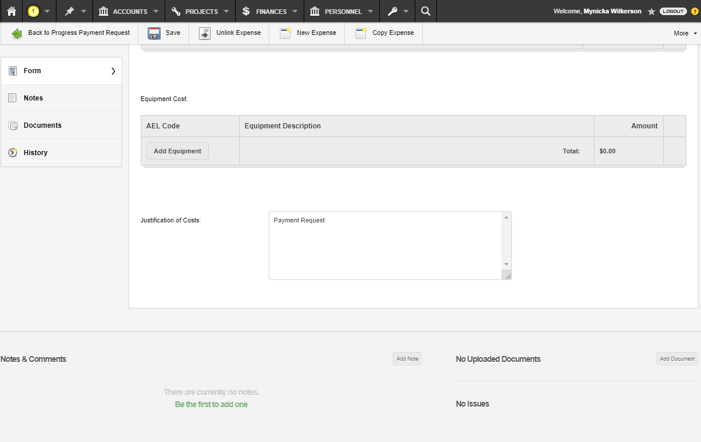
Select Add Document and upload all supporting documentation.

Slide 14
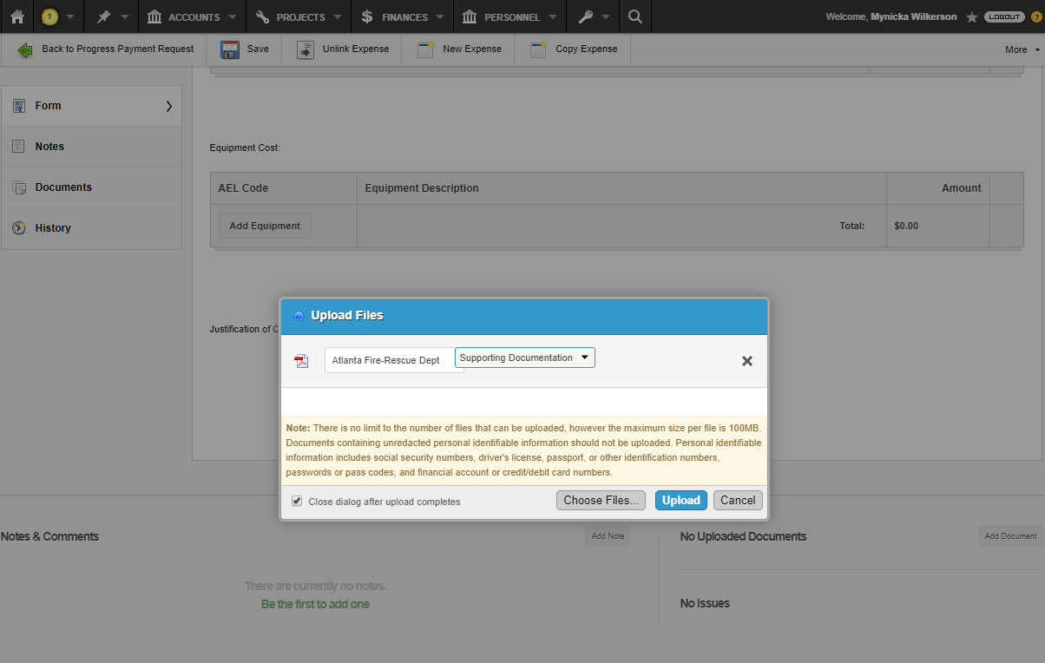
Upload your supporting documents.
Select Supporting Documentation from the Drop Down
Select Upload

Slide 15
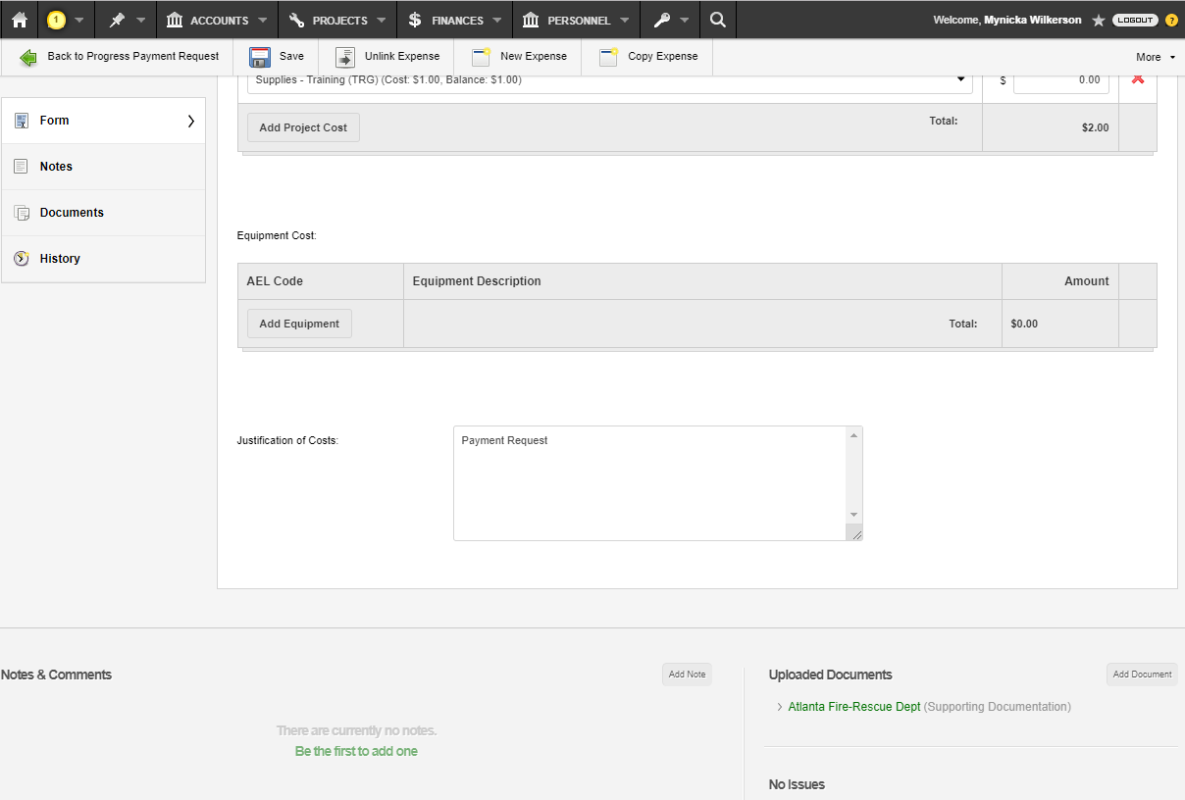
Select Back to Progress Payment Request

Slide 16
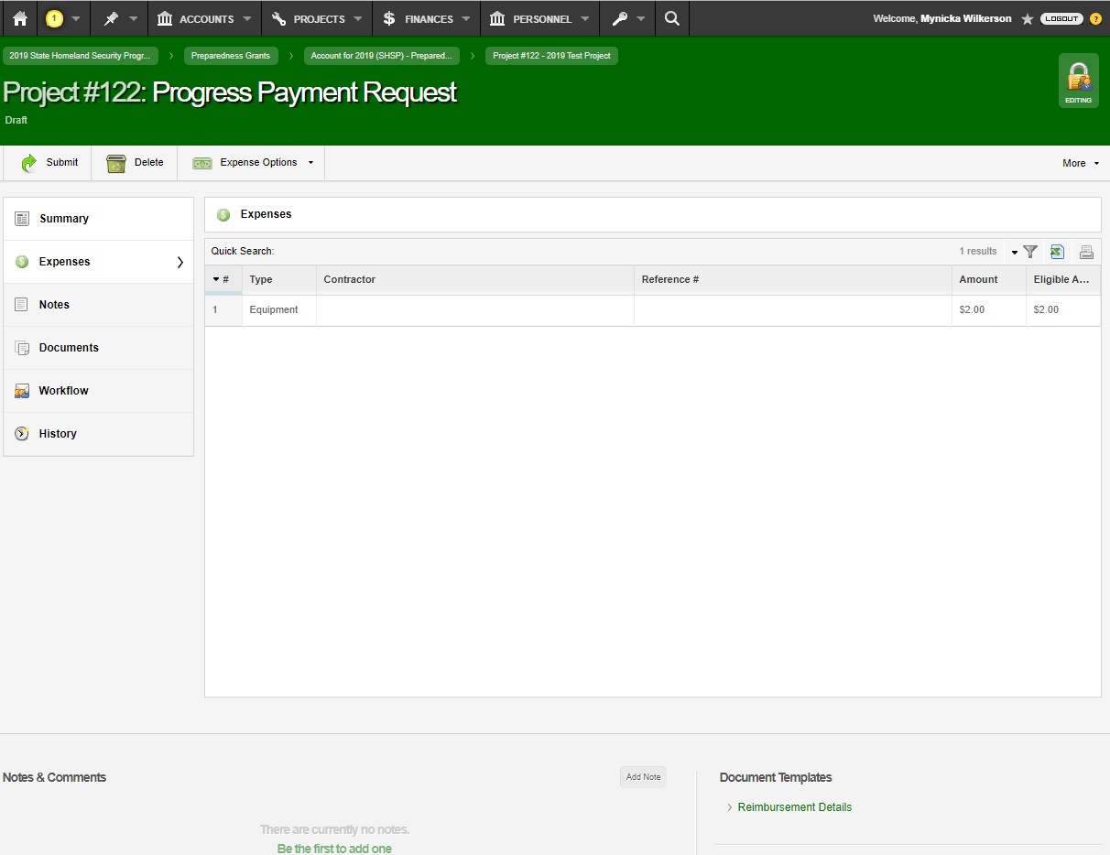
Select Submit

Slide 17
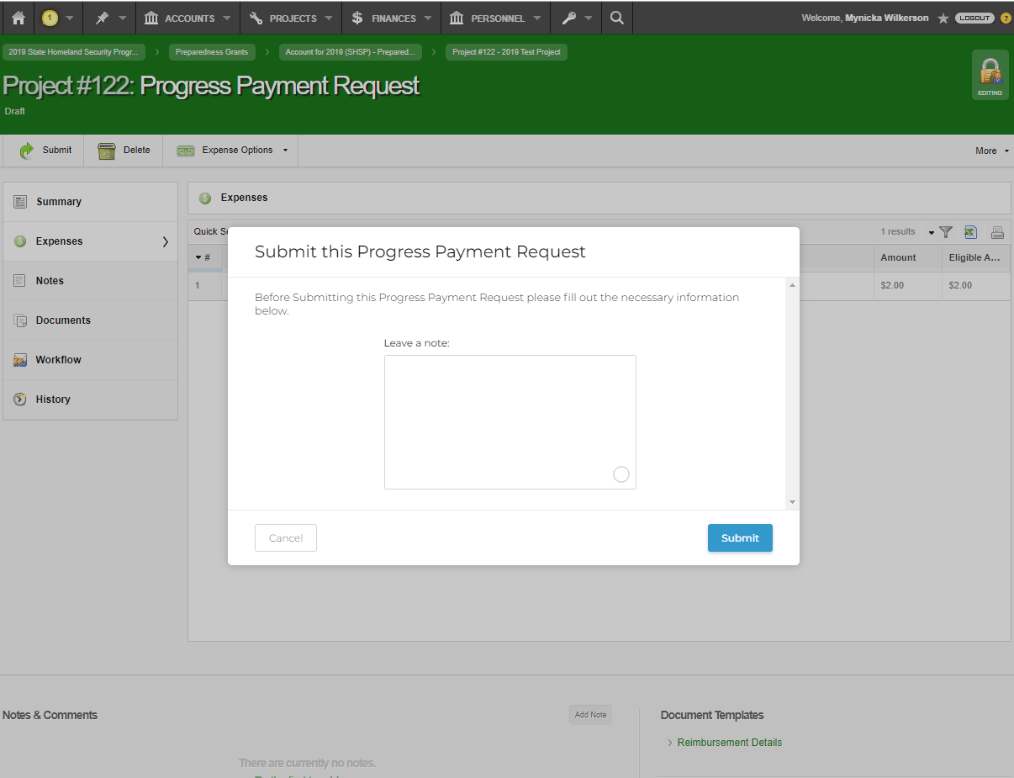
Leave a Note: Optional
Then select Submit

Slide 18
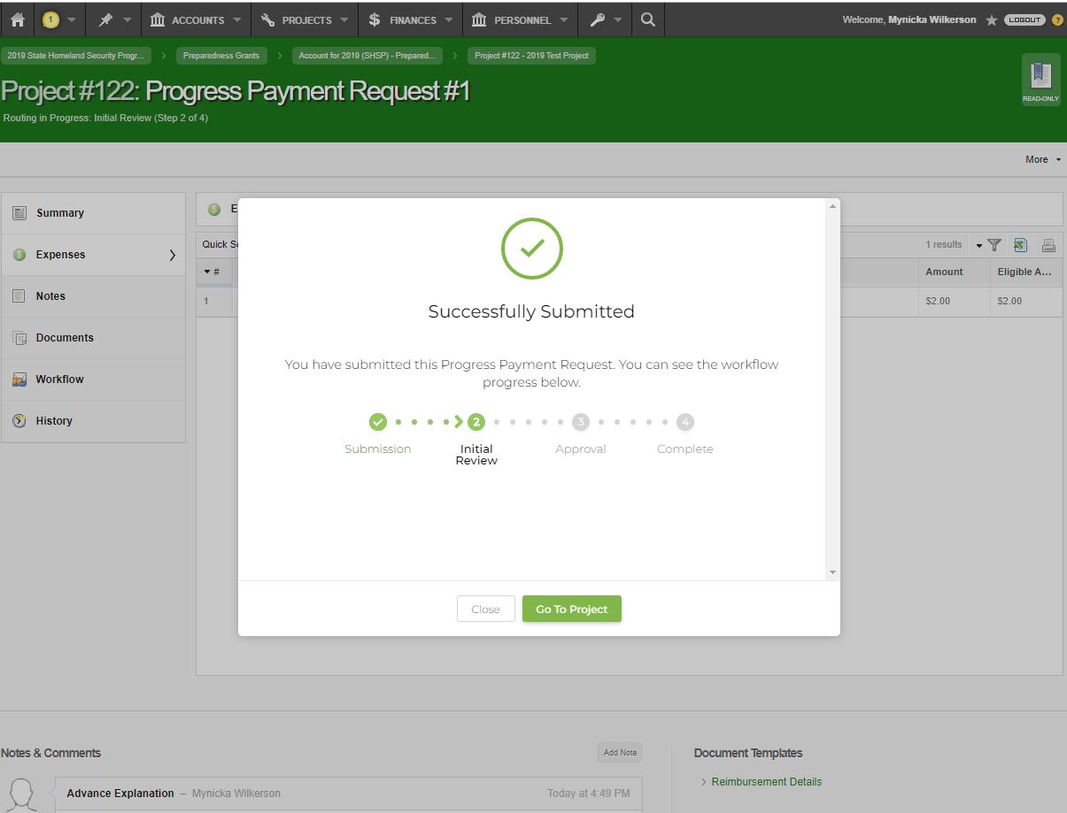
When you see “Successfully Submitted” your Payment Request has been submitted. *This will notify your GEMA/Homeland Security Grants Specialist*

Slide 19
Time Extensions

Slide 20
Select New Time Extension

Slide 21
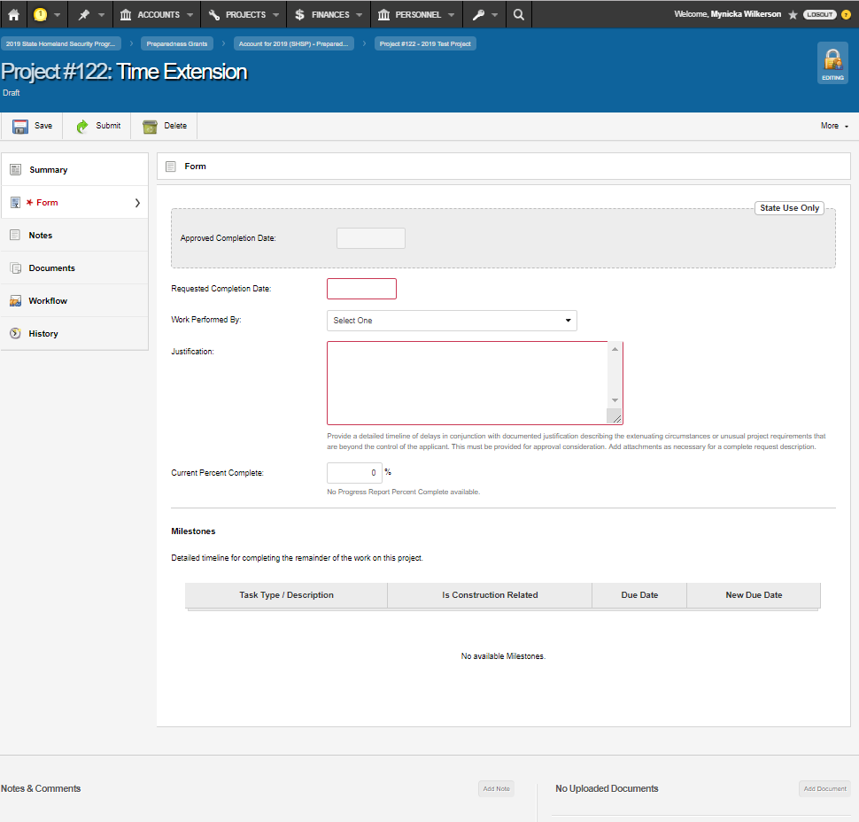
Enter New Requested Completion Date
Enter the justification in the Justification box
Select Add Document
Select Submit

Slide 22
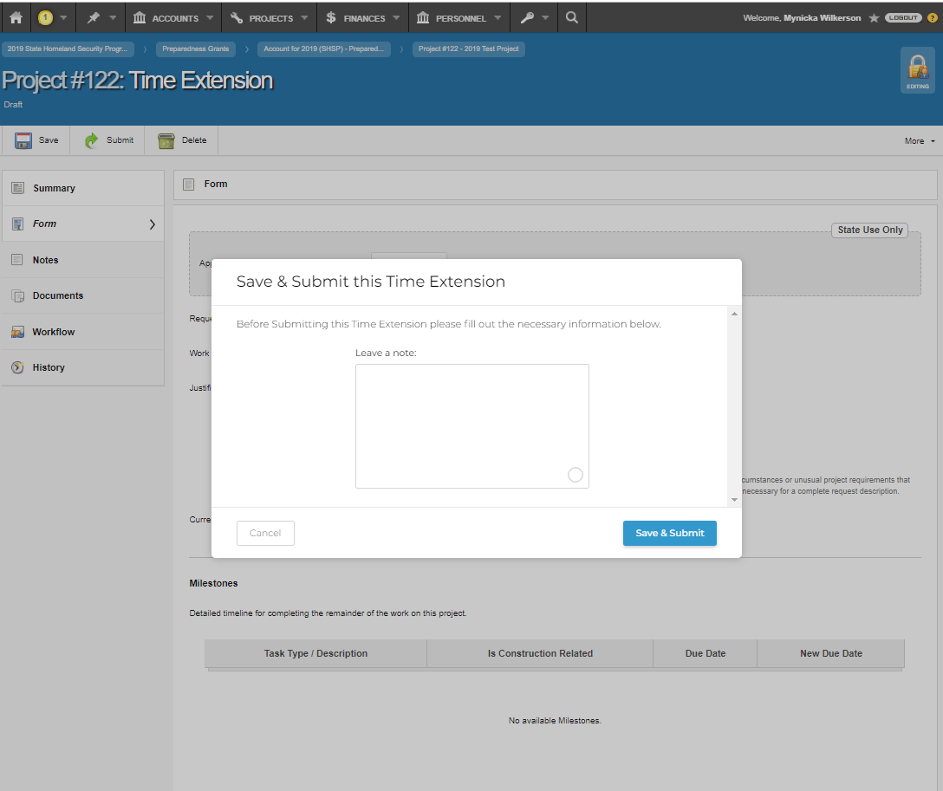
Leave a Note: Optional
Then select Save & Submit

Slide 23
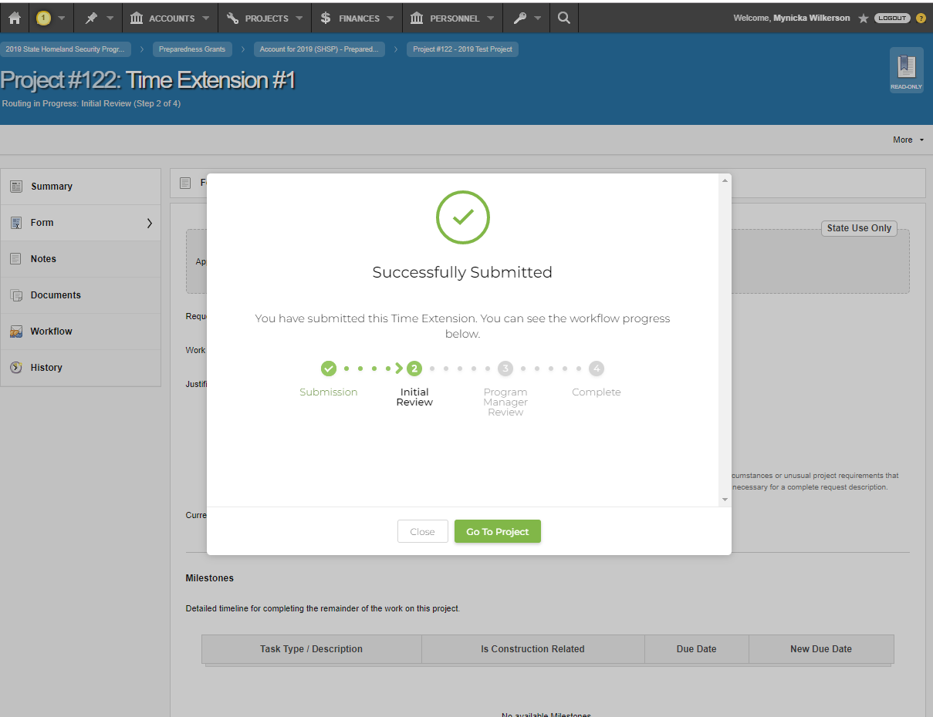
When you see “Successfully Submitted” your Time Extension has been submitted.
*This will notify your GEMA/Homeland Security Grants Specialist*

Slide 24
Budget Adjustments

Slide 25
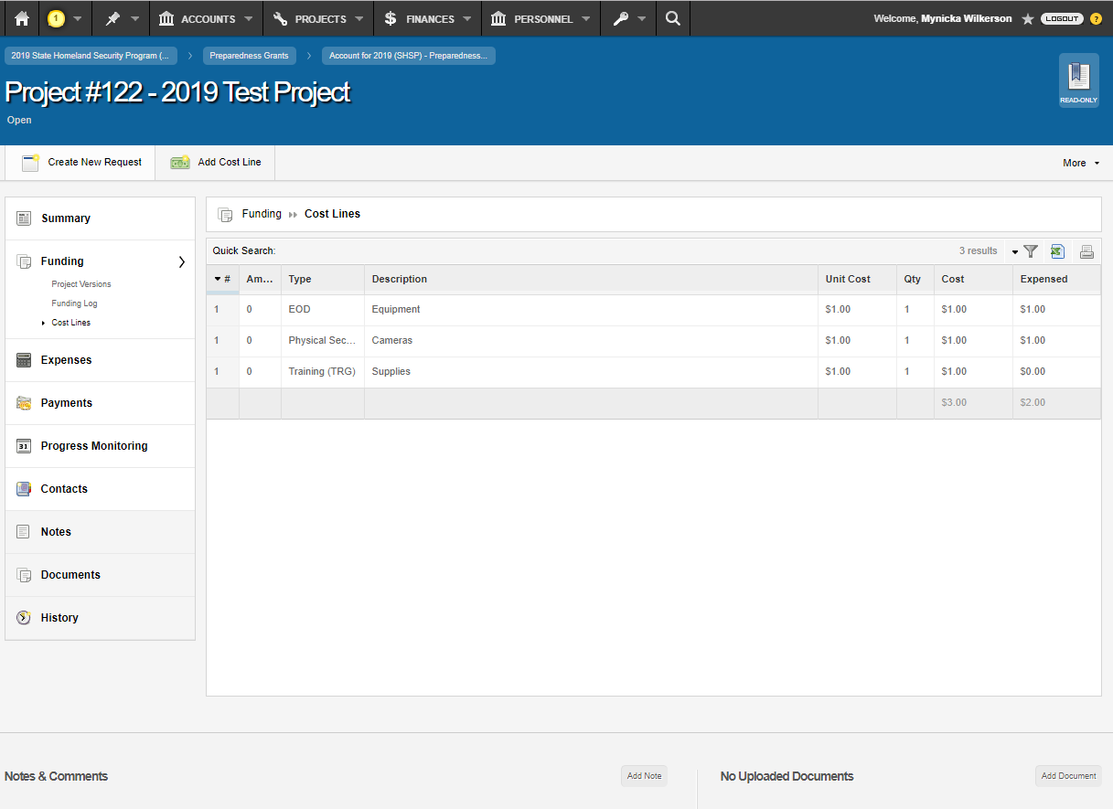
Select Funding
Select Cost Lines
Select Add Document

Slide 26
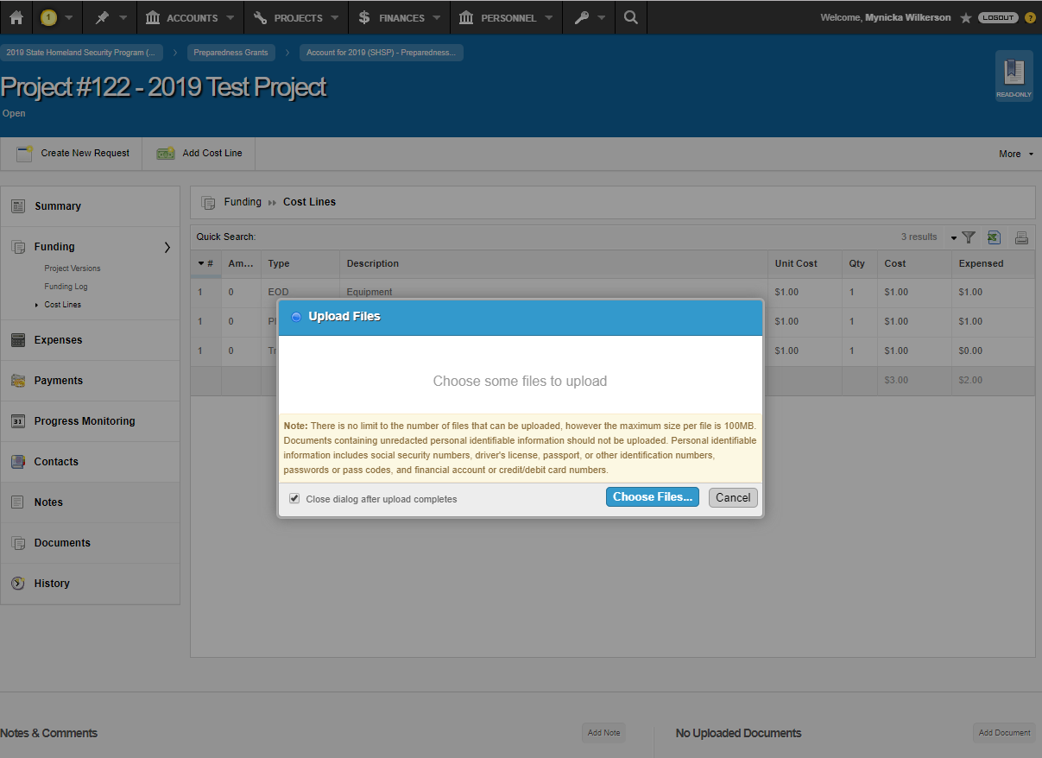
Upload your Budget Adjustment
Select Supporting Documentation from the Drop Down
Select Upload

Slide 27
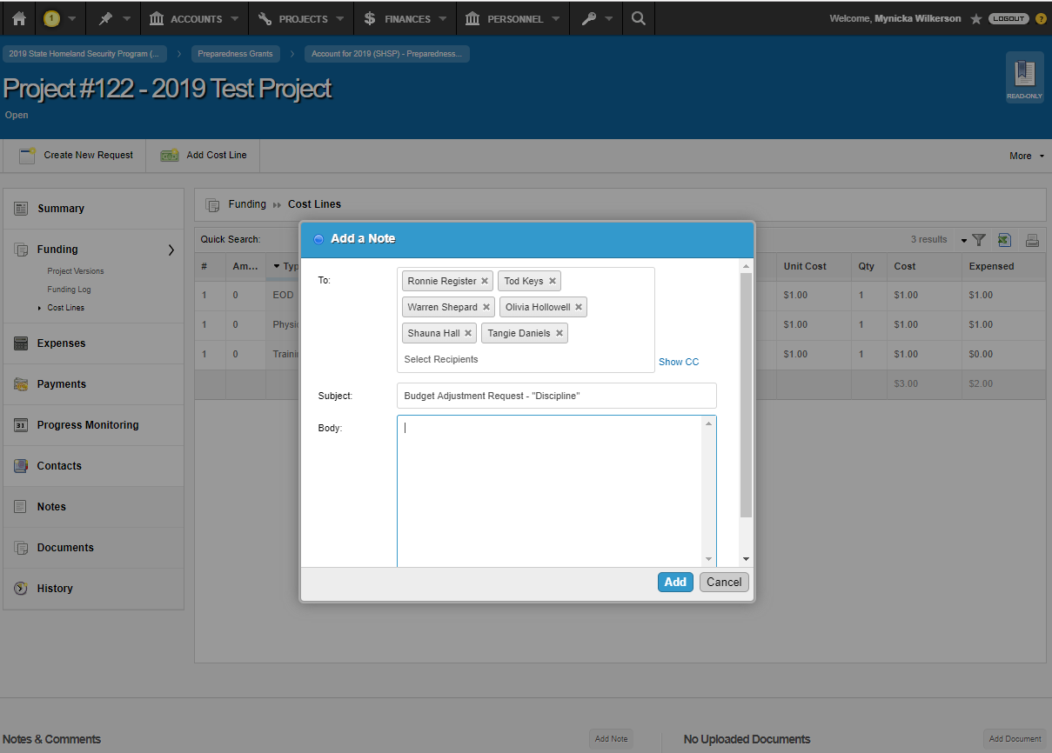
Select Add Note
Add the Program Managers and Grants Specialist as recipients
Enter “Budget Adjustment Request and the Discipline” in the Subject field
Select Add

Slide 28
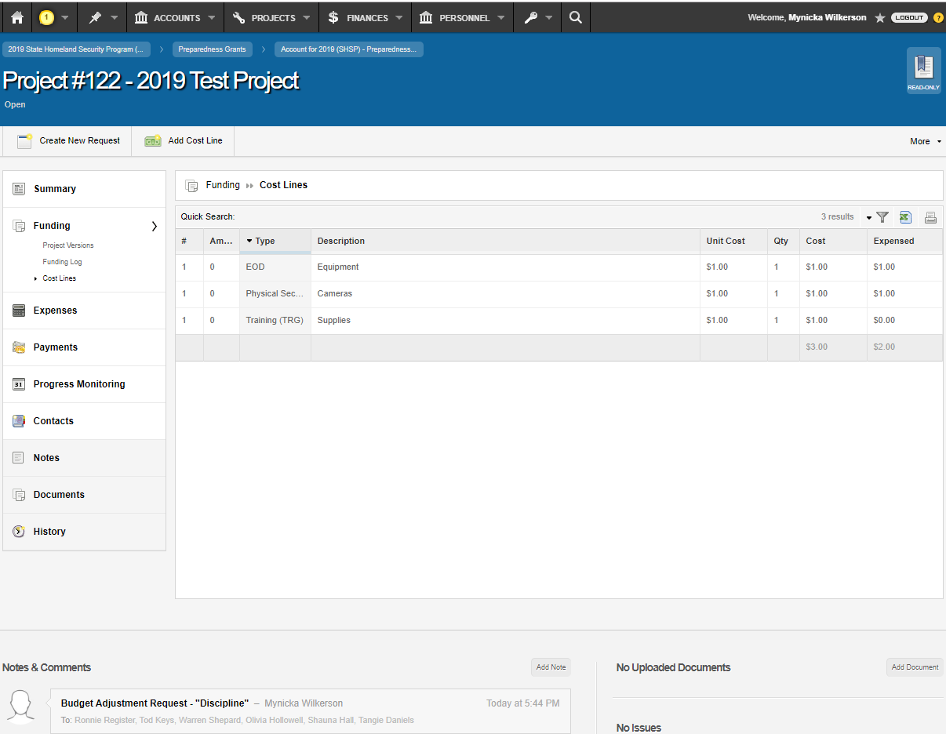
You have successfully submitted your Budget Adjustment.
*This will notify your GEMA/Homeland Security Grants Specialists and Program Manager*

Slide 29
Progress Reports

Slide 30
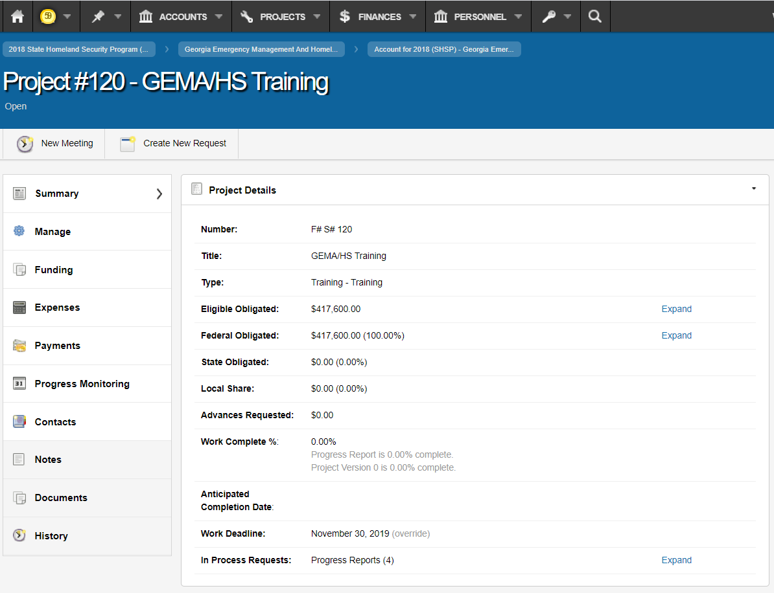
Select Progress Monitoring

Slide 31
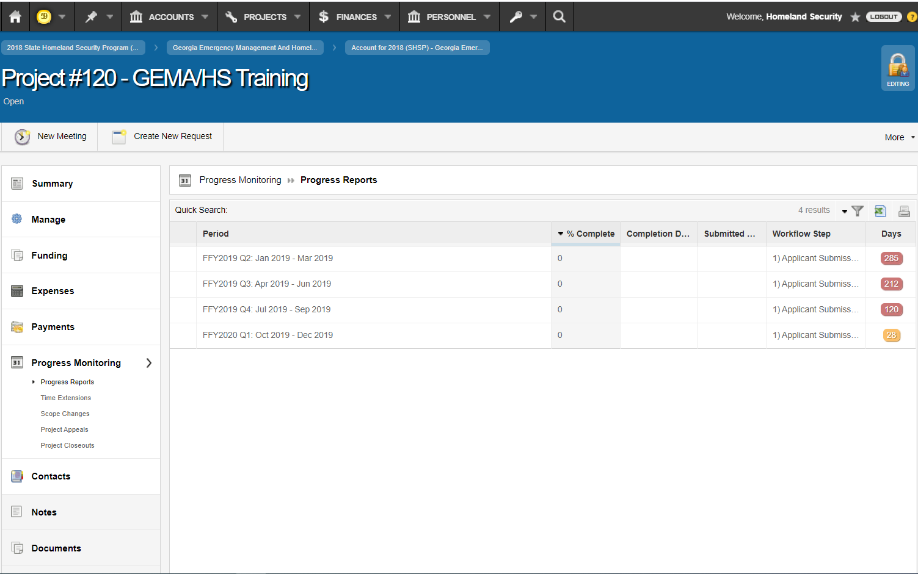
Select the Progress Report due for completion

Slide 32
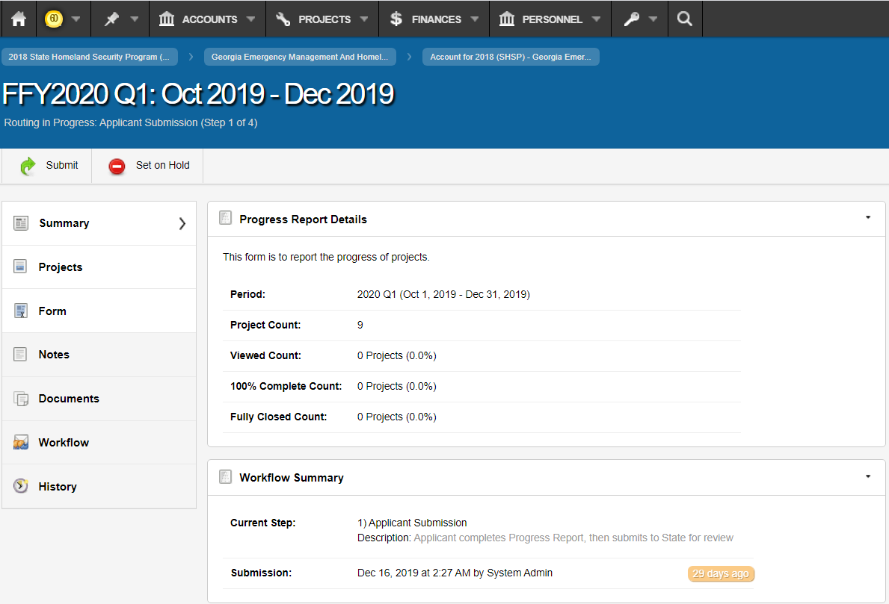
Select Form

Slide 33
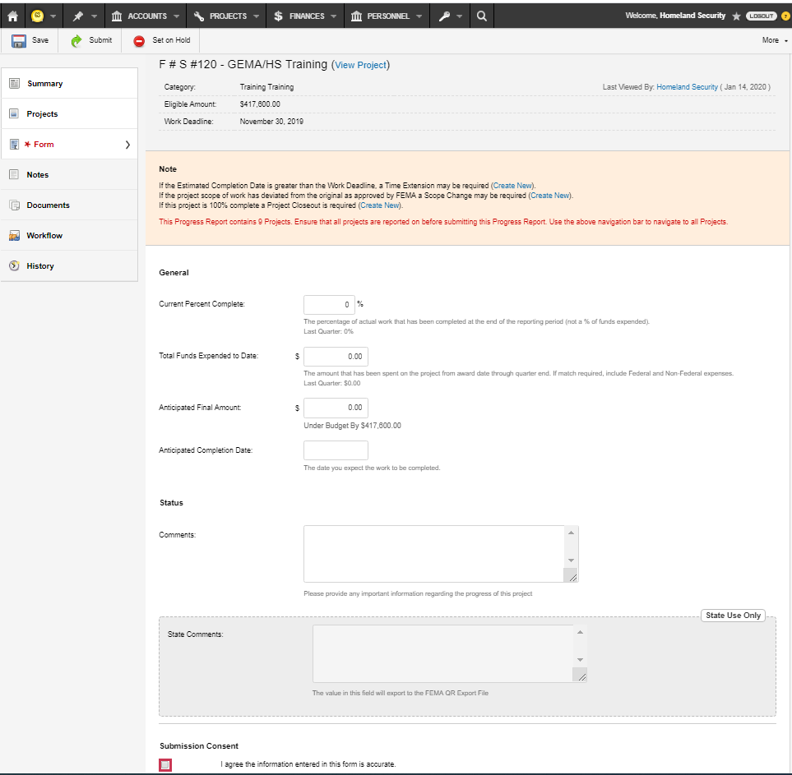
Please complete necessary information and Certify the information entered in the form is accurate.
Select Submit

Slide 34
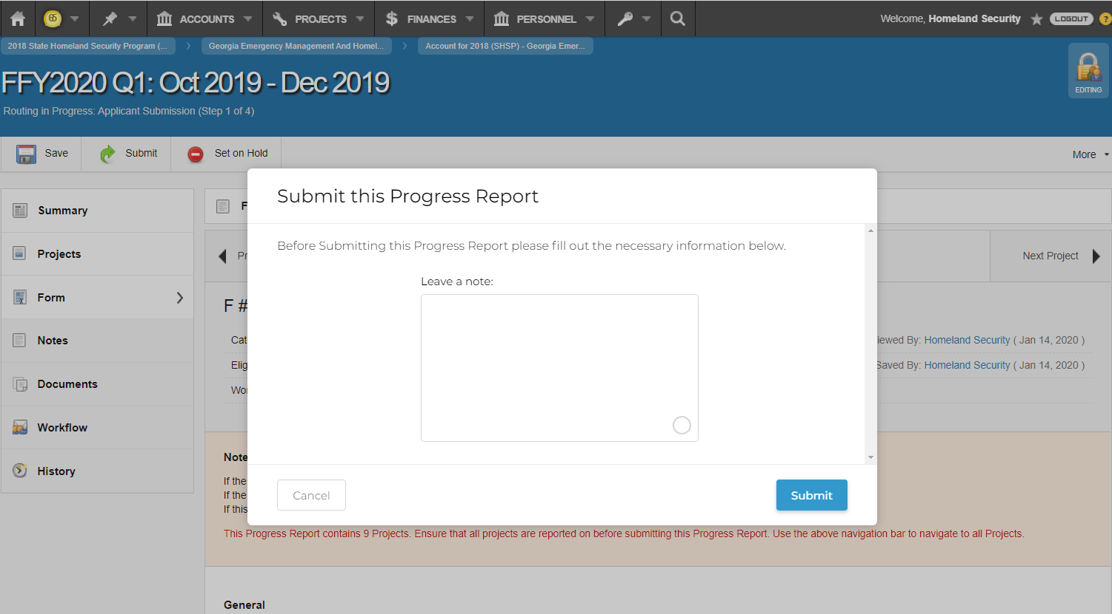
Leave a note for your Grant Specialist
Select Submit

Slide 35
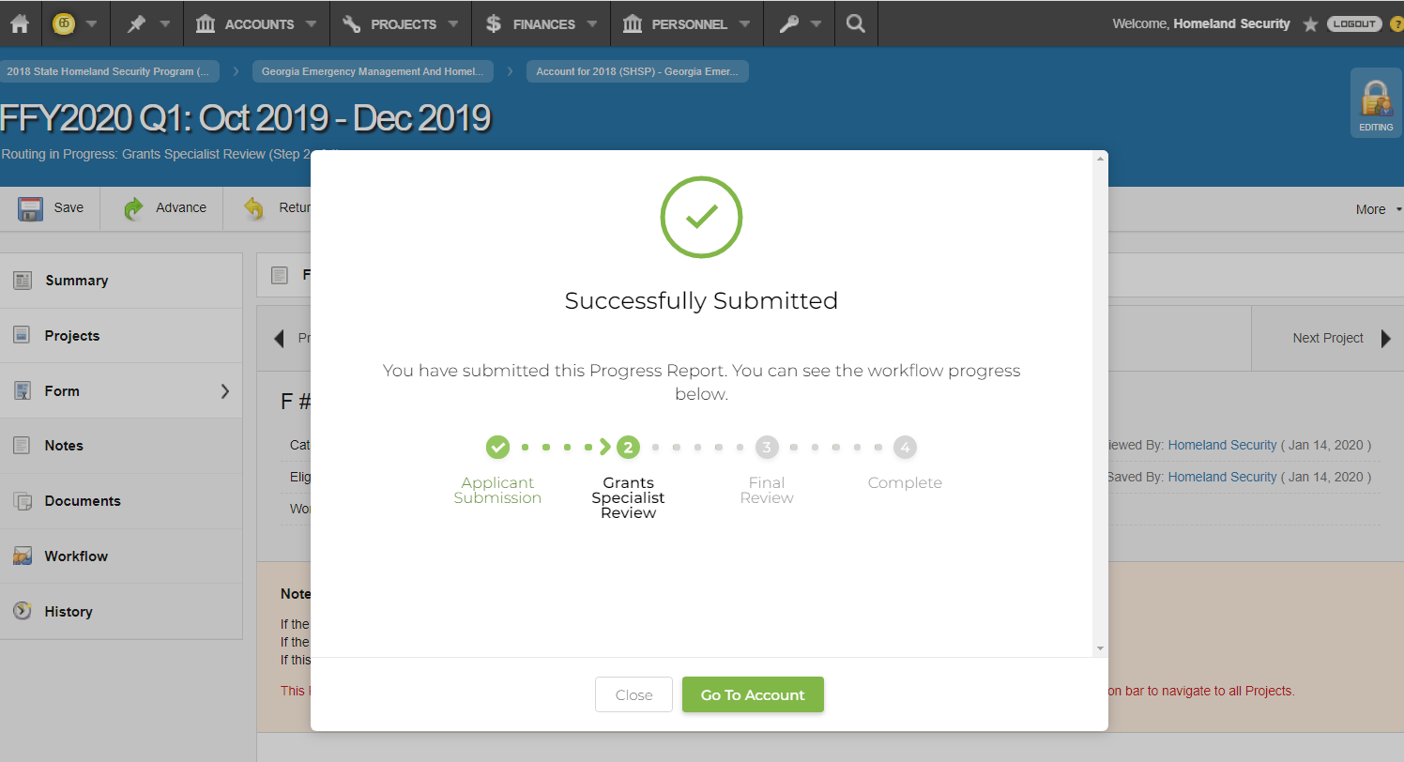
When you see “Successfully Submitted” your Progress Report has been submitted.
*This will notify your GEMA/Homeland Security Grants Specialist*

Slide 36
Access Memorandum of Understanding (MOU)

Slide 37
There are two Memorandum of Understandings designated for the Homeland Security Grant Program (HSGP) and/or Nonprofit Security Grant Program (NSGP) and one for the Emergency Management Performance Grant (EMPG).
The MOU is required to gain access to the grants portal… Georgia EMGrantsPro. https://ga.emgrants.com

Slide 38
Chief Elected/Appointed Official or Chief Executive Officer must sign the MOU. (Chairman of the Board of Commissioners, Mayor, Sheriff, Executive Director (NSGP)).
Please list Contact Agents accordingly.

Slide 39
Frequently Asked Questions (FAQ)

Slide 40
Frequently Asked Questions (FAQ)
Are we required to complete a MOU for all grants?
  No, you are required to complete an access MOU for all Homeland Security Grants and the Emergency Management Performance Grant to gain access to the grants portal.
How do we update our MOU with new contacts?
  Please email an updated Exhibit A to hsgrants@gema.ga.gov . This request must come from one of the contact agents already listed on the MOU.
Can the County Manager or County Administrator sign the MOU?
  If the County Manager or County Administrator has signatory authority, “YES” they can sign the MOU , providing supporting documentation of this authority.
Do we have to use EMGrants to apply for grants?
  Yes, you are required to use EMGrants to apply for Homeland Security Grants and the Emergency Management Performance Grant.
When do we start using the system in its entirety (Payment Requests, Advance Requests, Progress Reports, Time Extensions, Budget Adjustments, etc.)?
  Enter all data related to the 2019 Homeland Security Grant Program, Nonprofit Security Grant Program, and Emergency Management Performance Grants into EMGrants.

Slide 41
Preparedness Grants & Programs
Hsgrants@gema.ga.gov
(404) 635-7095

